Slide 1



BANK LOAN CASE
STUDY
WWW.TRAINITY.COM

Slide 2
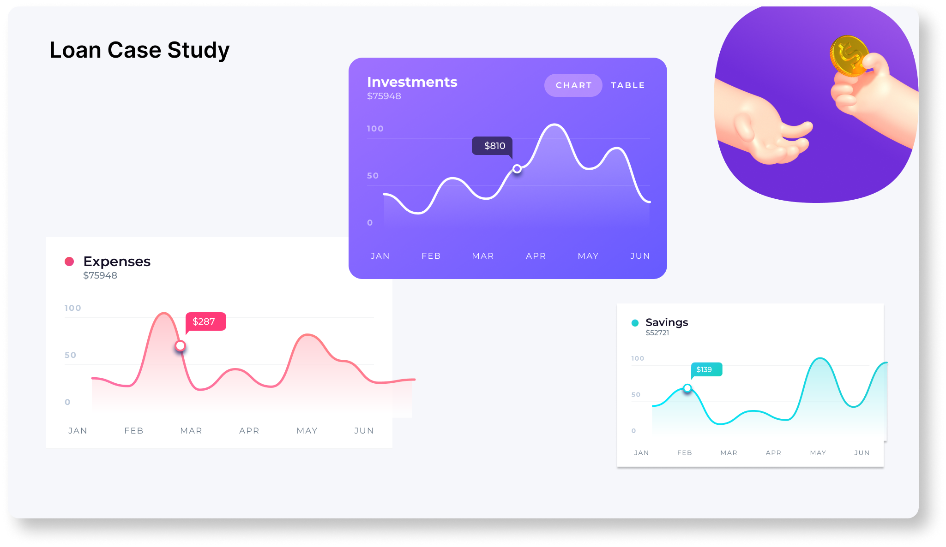

Slide 3

CONTENT
01
PROJECT DESCRIPTION
02
APPROACH
03
TECH STACK USED
04
INSIGHTS
05
RESULT
06
CONCLUSION

Slide 4



PROJECT DESCRIPTION:
Analysis done on the following points: To identify patterns which indicate if a client has difficulty paying their installments which may be used for taking actions such as denying the loan, reducing the amount of loan, lending (to risky applicants) at a higher interest rate, etc. This will ensure that the consumers capable of repaying the loan are not rejected. Analysis is being done into two parts or say two dataset :
1. Application data
2. Previous application data

Slide 5



APPROACH AND TECH-STACK USED
Approach
I will begin by understanding the loan application dataset, then clean and preprocess the data.
After that, I'll use exploratory data analysis (EDA) to uncover patterns linking customer and loan attributes to approval outcomes, aiming to improve decision-making and minimize defaults.
Tech-Stack Used
Tech-Stack Used in this project is MS Excel for data cleaning, preprocessing, and initial data analysis tasks.

Slide 6

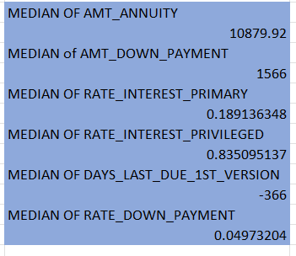
PREVIOUS APPLICATION DATASET
Task 1:Dropping, Imputing and analyzing Null values
Dropping the irrelevant columns:
1.HOUR_APPR_PROCESS_START 2.WEEKDAY_APPR_PROCESS_START_PREV
3.FLAG_LAST_APPL_PER_CONTRACT
4.NFLAG_LAST_APPL_IN_DAY
5.SK_ID_CURR
6.WEEKDAY_APPR_PROCESS_START
Analyzing Null Values and replacing it with median:

Slide 7
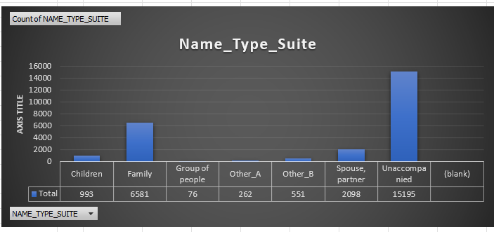
PREVIOUS APPLICATION DATASET
Task 1:Dropping, Imputing and analyzing Null values:
NAME_TYPE_SUITE: Replace Null values using Unaccompanied.

Slide 8
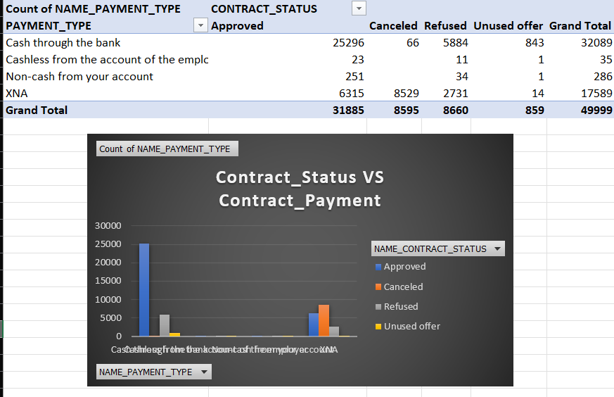
PREVIOUS APPLICATION DATASET
Task: Bivariate Analysis of NAME_PAYMENT_TYPE VS NAME_CONTRACT_STATUS

Slide 9
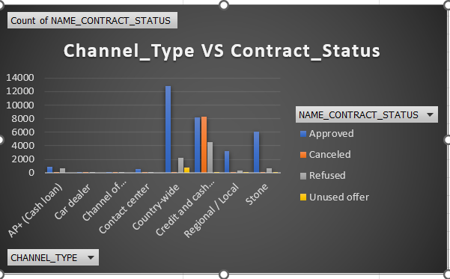
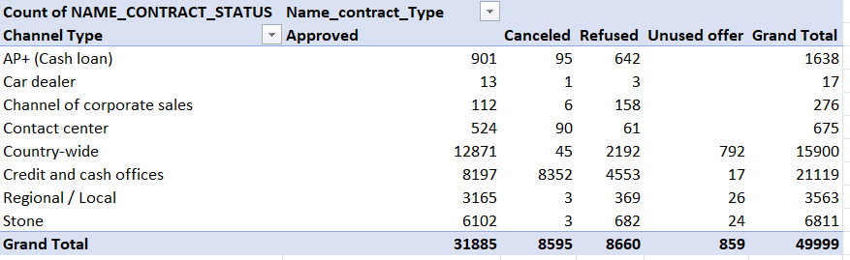
PREVIOUS APPLICATION DATASET
Task: Bivariate Analysis of CHANNEL_TYPE VS NAME_CONTRACT_STATUS

Slide 10
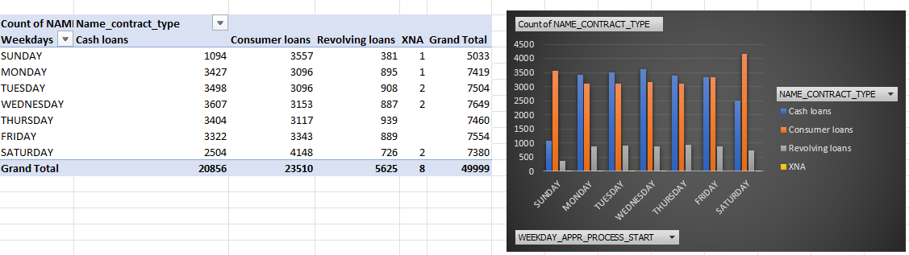
PREVIOUS APPLICATION DATASET
Task: Bivariate Analysis of WEEKDAYS VS NAME_CONTRACT_TYPES

Slide 11
APPLICATION DATASET
Task1: Identify Missing Data and dealing with it!!!
1.Removing Duplicates.
2. Finding Missing Value: Missing values are those which are not available in our dataset should be handled. First I found the count of null or missing values in each column using COUNTBLANK function in Excel and also calculated percentage of null values in each column.
3.Handling Missing Values: After finding the percentage of Missing values in each column and I deleted the columns which are having blanks percentage more than 50 %.

Slide 12
APPLICATION DATASET
Task1: Identify Missing Data and dealing with it!!!
4.Removing irrelevant data: It is always beneficial to remove unnecessary columns which helps in better data analysis.
5. Dealing with Null Values: There are so many techniques to deal with null values a.k.a missing values like mean, median, mode, imputation, replacing, deletion ,etc.
For this project, I have used median and mean to deal with continuous data and for categorical data, I used mode.

Slide 13
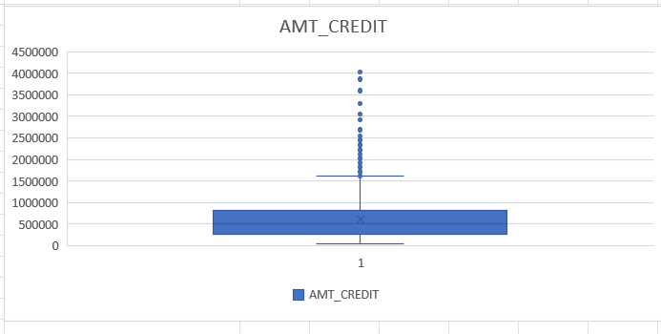
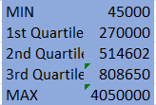
APPLICATION DATASET
Task 2: Identify Outliers in the Dataset
Box Plot for AMT_CREDIT:

Slide 14
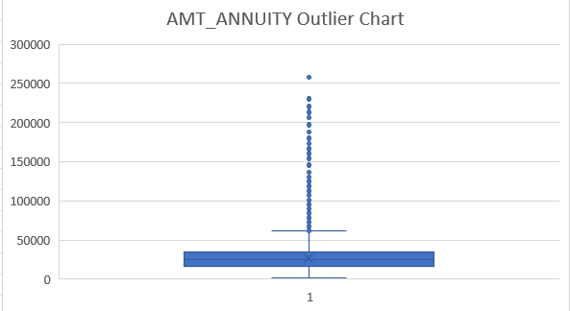
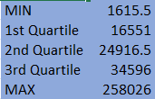

APPLICATION DATASET
Task 2: Identify Outliers in the Dataset
Box Plot for AMT_ANNUITY:

Slide 15
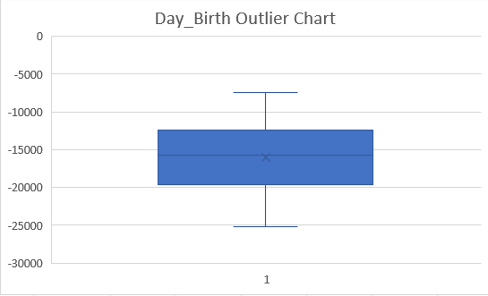
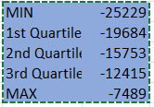
APPLICATION DATASET
Task 2: Identify Outliers in the Dataset
Box Plot for DAY_BIRTH:
No outlier present

Slide 16
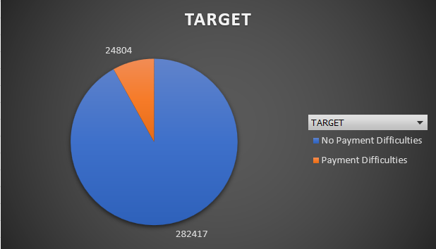
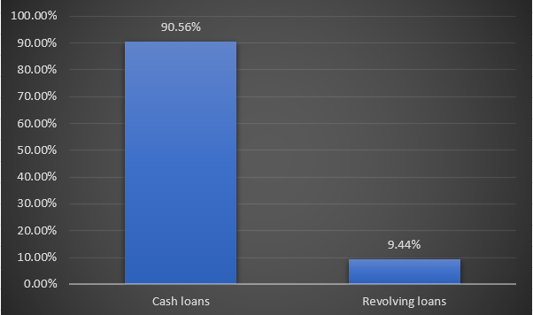
APPLICATION DATASET
Task: Exploratory Data Analysis
Target:
NAME_CONTRACT_TYPE:

Slide 17
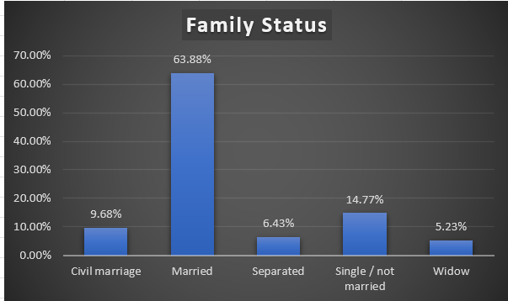
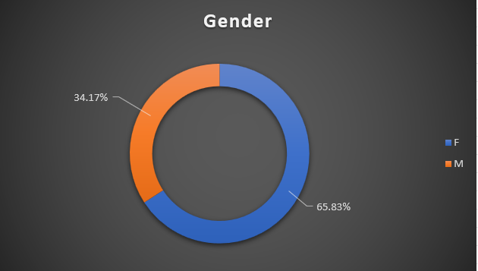
APPLICATION DATASET
Task: Exploratory Data Analysis
Family_ Status:
Gender:

Slide 18
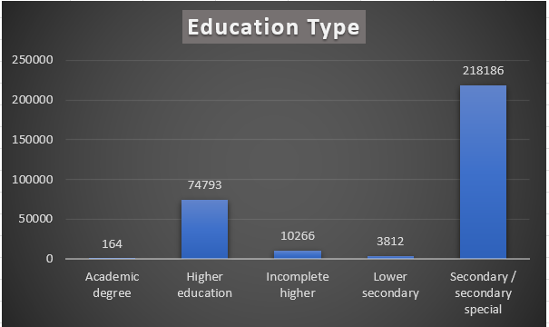
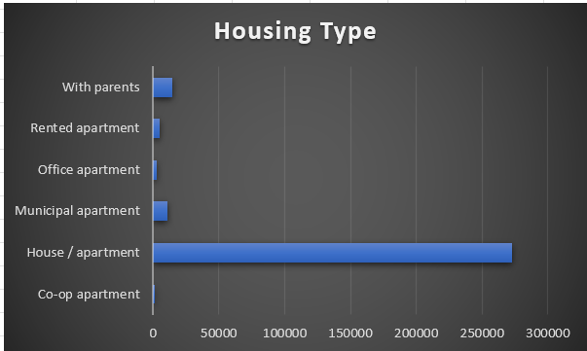
APPLICATION DATASET
Task: Exploratory Data Analysis
Education Type:
Housing_Type:

Slide 19
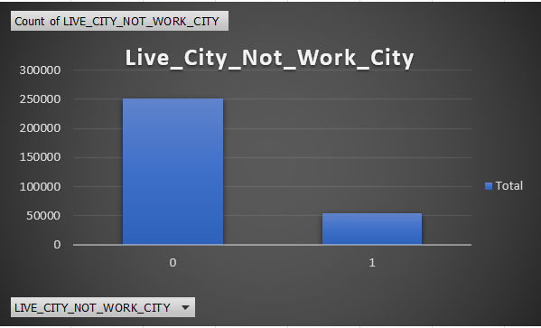
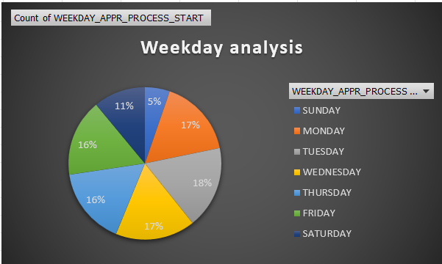
APPLICATION DATASET
Task: Exploratory Data Analysis
Live_City_Not_Work_City:
Weekday Analysis:

Slide 20
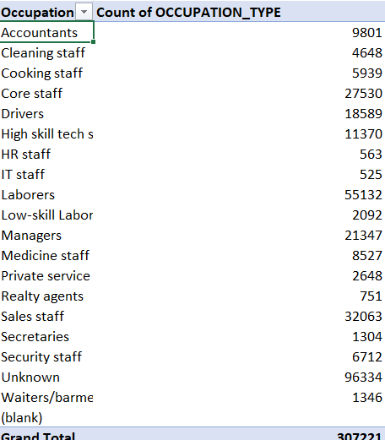
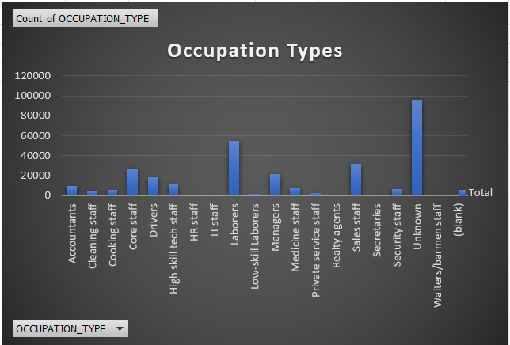
APPLICATION DATASET
Task: Exploratory Data Analysis
Occupation Type:

Slide 21
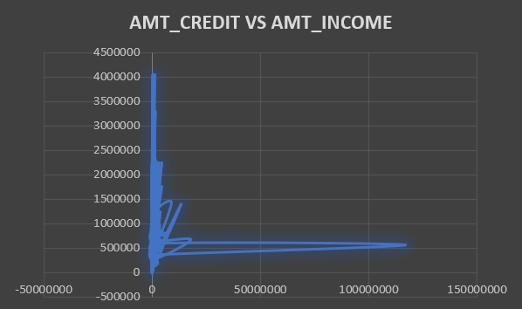

APPLICATION DATASET
Task: Bivariate Analysis of AMT_CREDIT VS AMT_INCOME

Slide 22
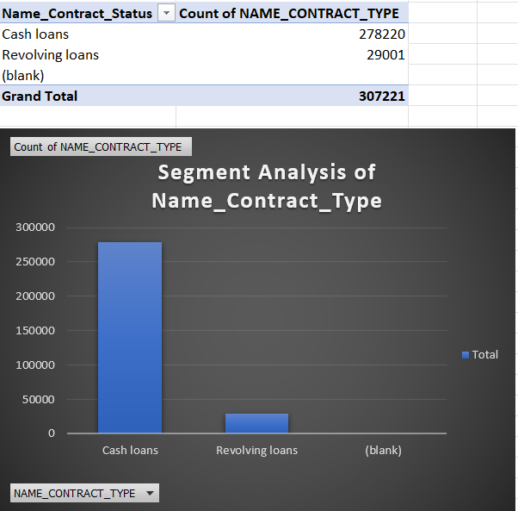
APPLICATION DATASET
Task: Segment Analysis of Name Contract Type :- It is done by filter method.

Slide 23





RESULTS AND CONCLUSIONS
Application dataset:
Previous Dataset:
Clients with Academic degrees have a strong track record of timely loan repayments.
Female clients show higher loan repayment reliability compared to males.
Revolving loan clients face fewer repayment difficulties.
Older clients (above 60) exhibit robust loan repayment capabilities.
Students and business owners demonstrate smooth loan repayment experiences.
A higher credit amount is positively correlated with a higher approval likelihood.
New clients enjoy a high approval rate, reaching up to 90%.
Corporate sales applications experience the highest rejection rates, up to 55%.

Slide 24
DRIVE LINKS
Application dataset:
Previous Dataset:
https://docs.google.com/spreadsheets/d/1ZlP1KXVxIWoOA2xkZFd0pFAJUh_JK9rr/edit?usp=drive_link&ouid=104159851622002118898&rtpof=true&sd=true
https://docs.google.com/spreadsheets/d/1jjqhCYYmhBDtqm3-hWCvV1cAcTfKUXgC/edit?usp=sharing&ouid=104159851622002118898&rtpof=true&sd=true

Slide 25



THANK YOU
komalbarhate2004@gmail.com
https://www.linkedin.com/in/komal-barhate-18a36225a/

